Slide 1
Hydrology signature in superconducting gravimeter readings
Jiaxin Liu
Philipp Schollmeier
February 7th, 2023, Stuttgart

Slide 2
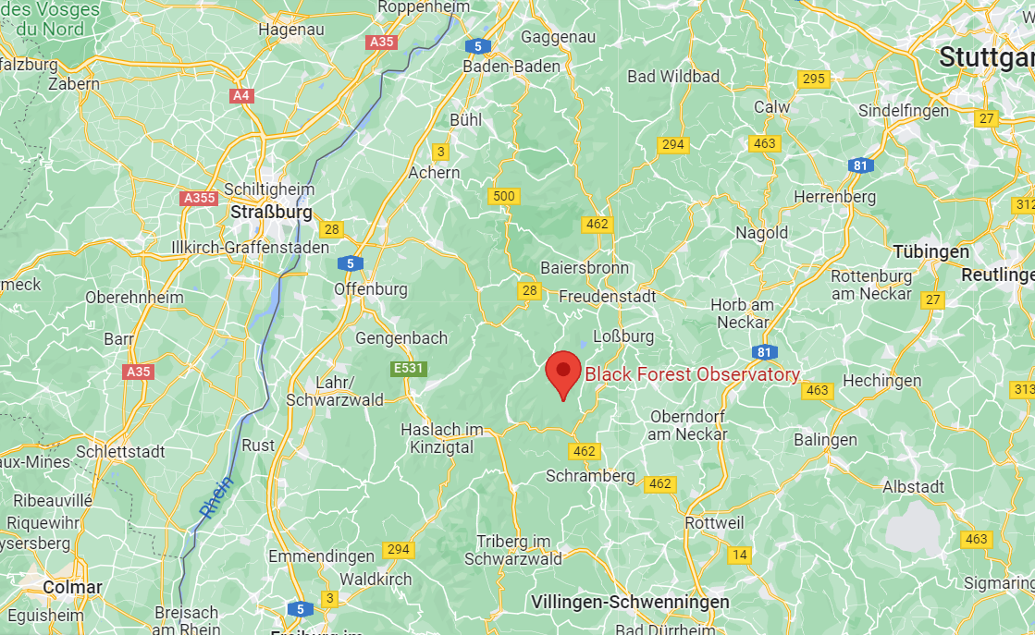
Measurement site
Fig. 1: Location of the BFO (Google Maps)
Black Forest Observatory near the village of Schiltach
Notes:
-In a remote location with few human sources of noise
-Granite bedrock -> less movement of ground with changing pressure

Slide 3
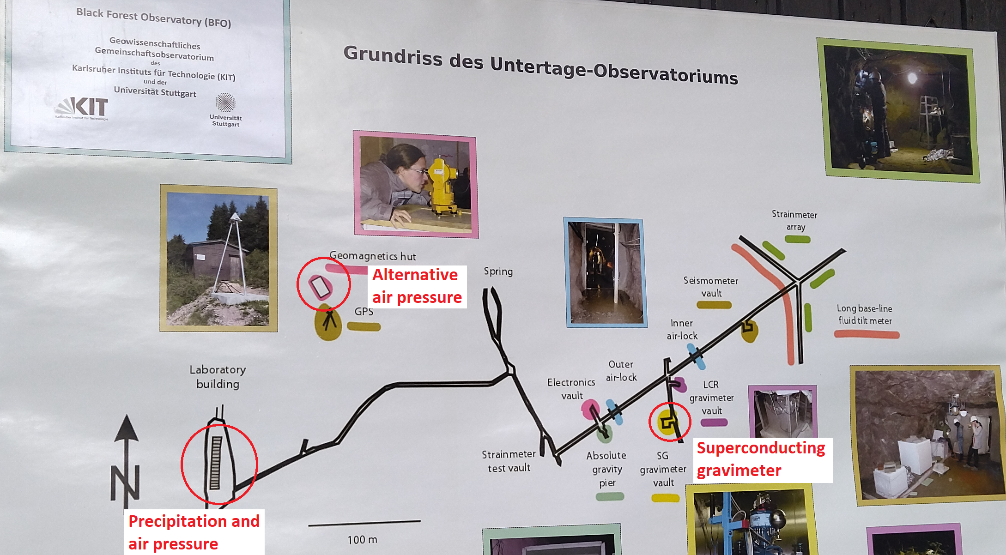
Measurement site
Fig. 2: Layout of the BFO (own picture)
SG in an old silver and cobalt mine
About 100 m under the surface
Notes:
-BFO is at the edge of a valley with a small creek, SG about 500 m inside mountain
-Stable temperature of around 8°C inside, air locks provide fairly stable pressure
-Not included in graphic are soil moisture probes

Slide 4
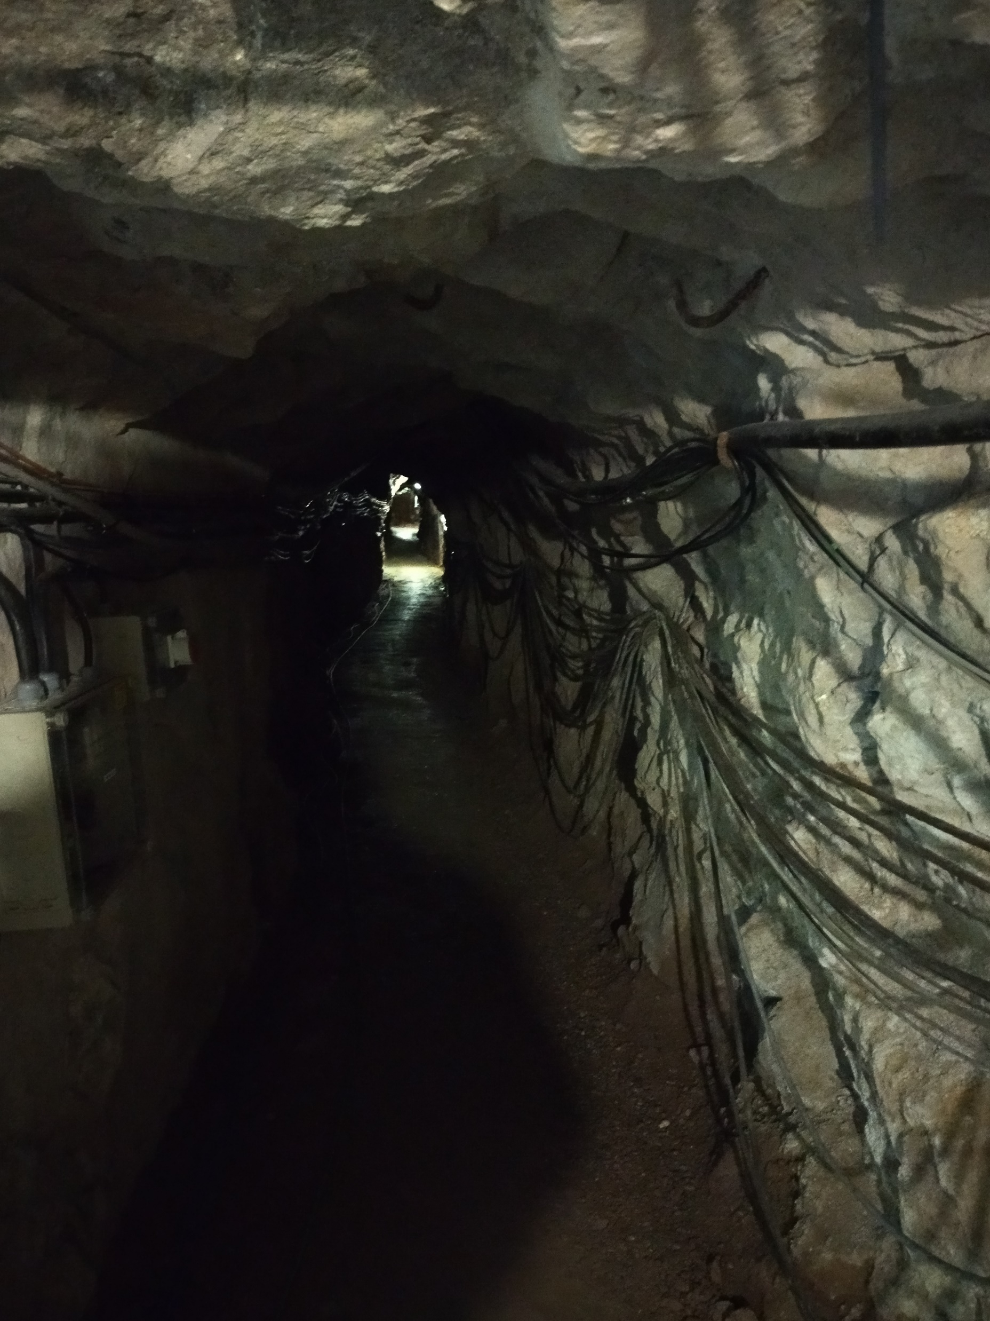
Measurement site
Fig. 3: Tunnel of the mine (own picture)
Notes:
- One of the cables connect SG and outside pressure gauge

Slide 5
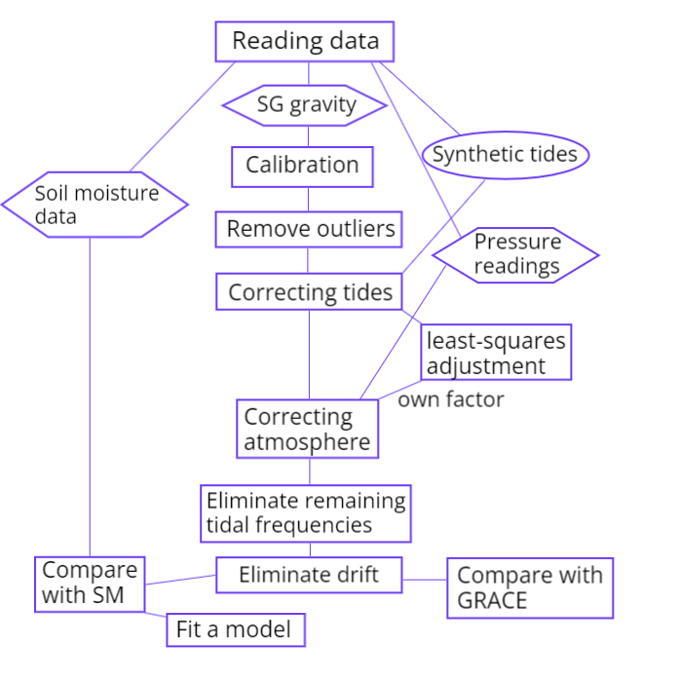
Workflow

Slide 6
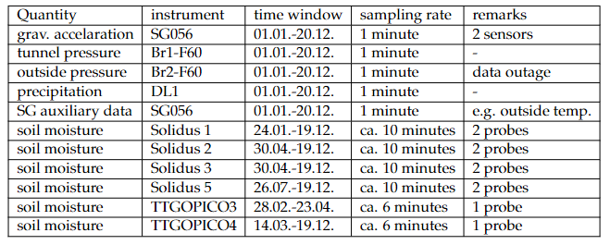
Data
Fig. 4: Overview of available data
All data are from 2022
Two sensors of the superconducting gravimeters SG056 – G1-F60 and G2-F60, vertical offset of 20 cm between them
Notes:
- RELATIVE measurements of gravity!

Slide 7
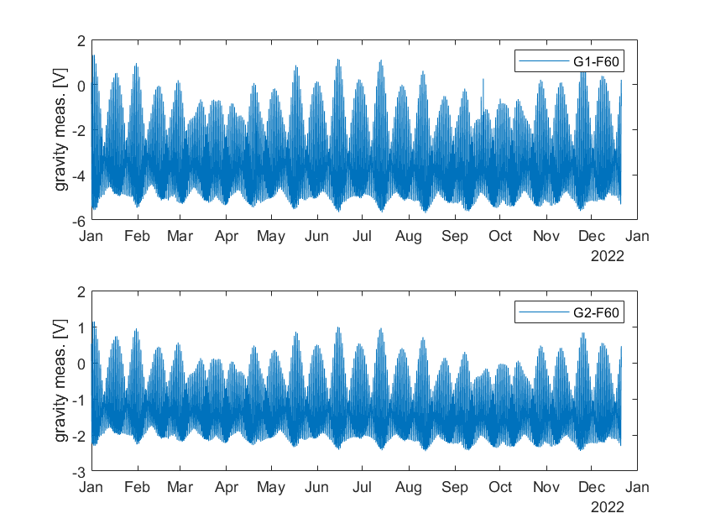
Data
Fig. 5: Uncalibrated gravity measurements of both sensors
Notes:
Outliers at G1-F60 in September
Different magnitudes of voltage

Slide 8
Calibration

Slide 9
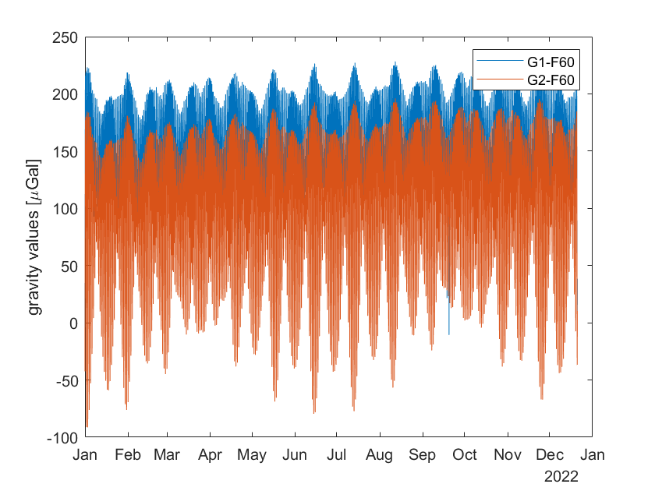
Calibration
Fig. 6: Calibrated measurements of both sensors
Given calibration coefficients for both sensors

Slide 10
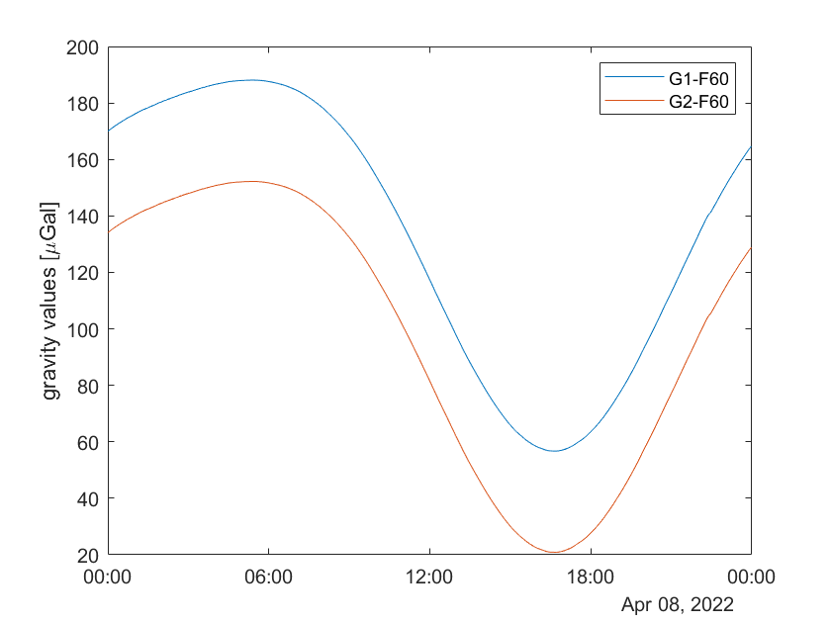
Calibration
Fig. 6: Calibrated measurements on April 8th

Slide 11
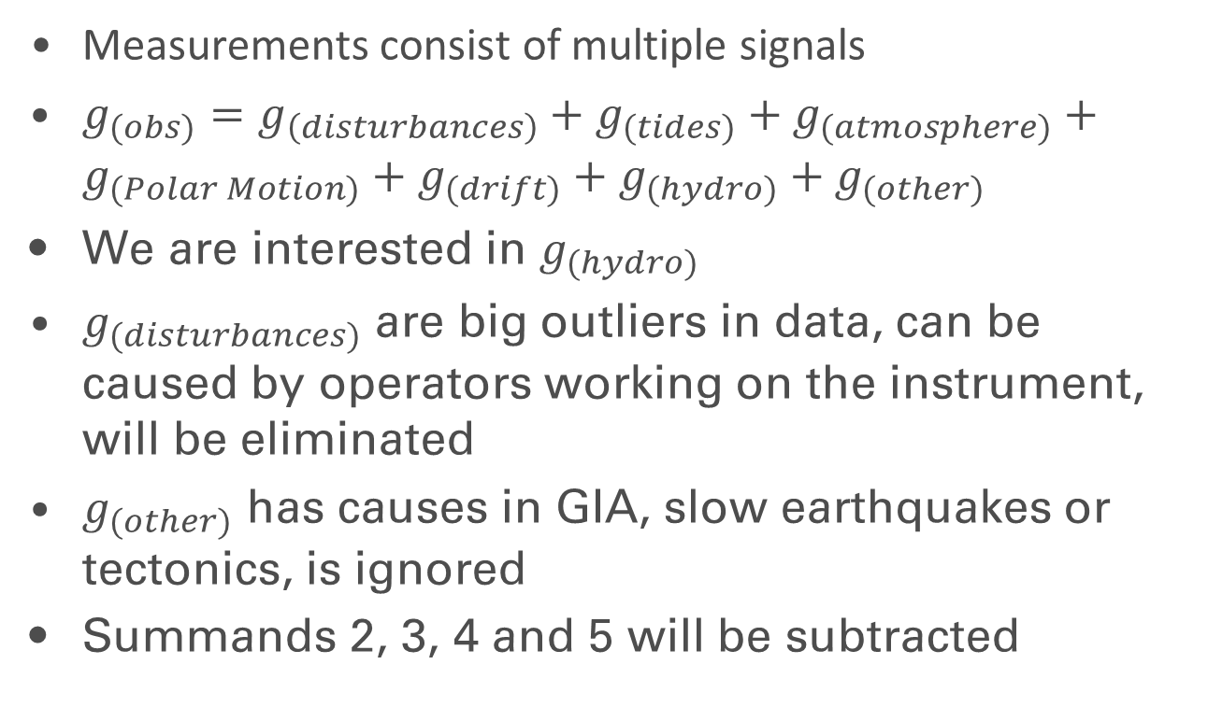
Corrections
Measurements consist of multiple signals
$g_{(obs)}=g_{\left(disturbances\right)}+g_{(tides)}+g_{(atmosphere)}+g_{(Polar Motion)}+g_{(drift)}+g_{(hydro)}+g_{(other)}$
We are interested in $g_{(hydro)}$
$g_{(disturbances)}$ are big outliers in data, can be caused by operators working on the instrument, will be eliminated
$g_{(other)}$ has causes in GIA, slow earthquakes or tectonics, is ignored
Summands 2, 3, 4 and 5 will be subtracted

Slide 12
Corrections

Slide 13
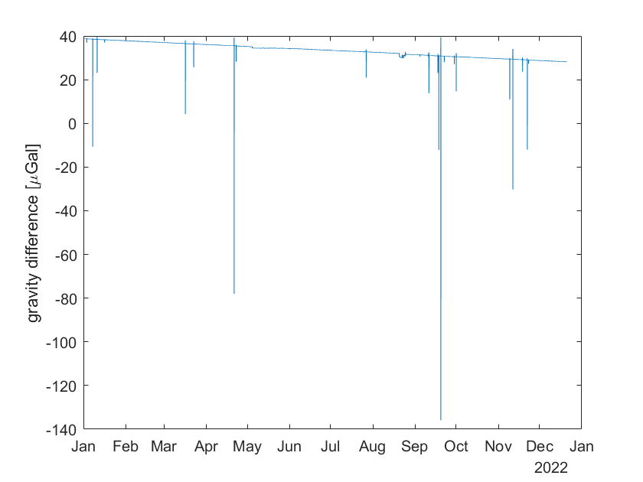
Removing outliers
Fig. 7: Differences between two sensors before outlier filtering

Slide 14
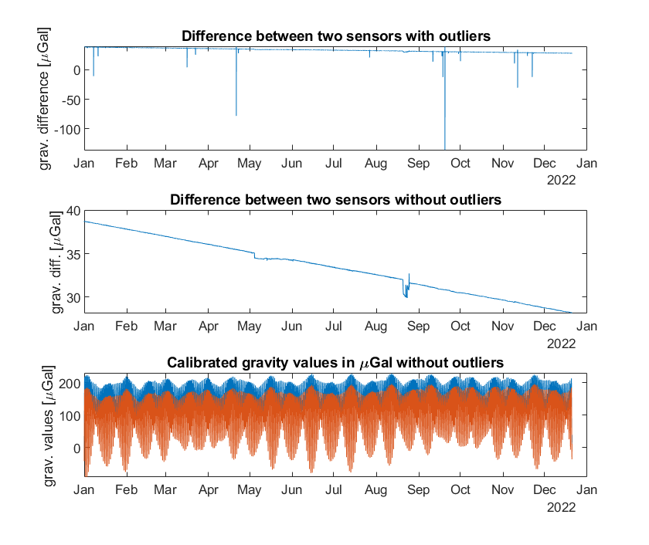
Removing outliers
Fig. 8: Removing outliers

Slide 15
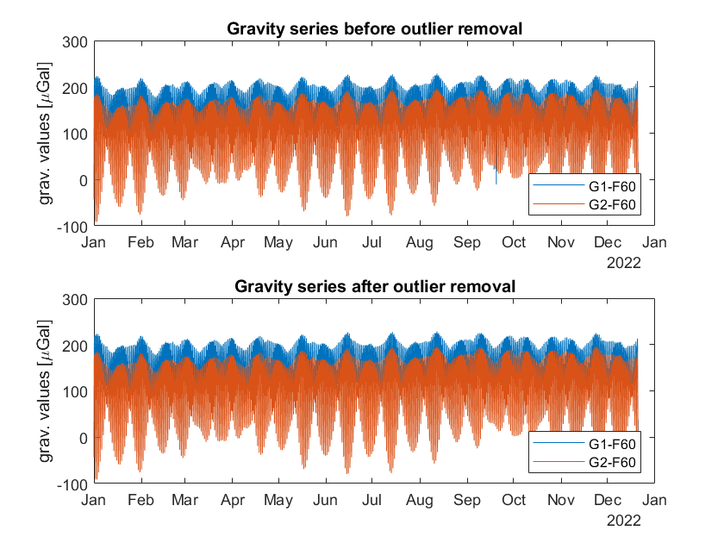
Removing outliers
Fig. 9: Comparison of gravity series before and after outlier removal

Slide 16
Tides

Slide 17
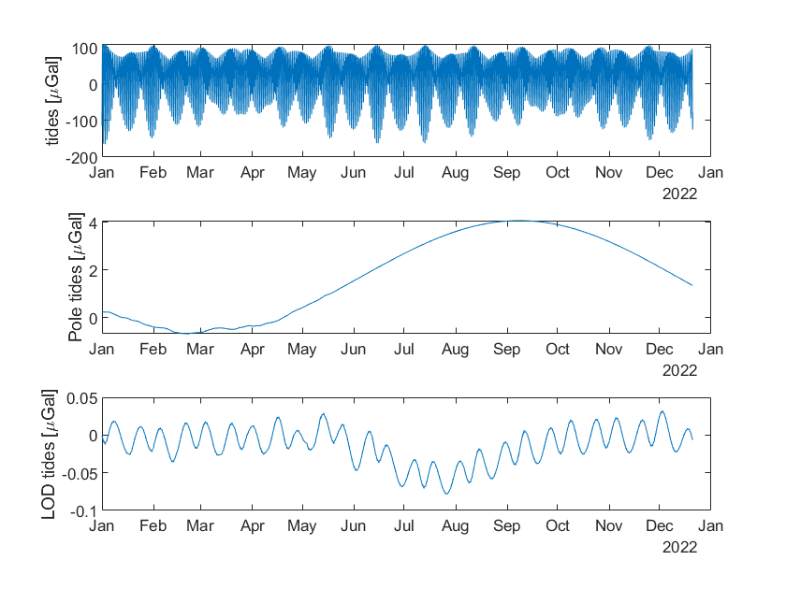
Tides
Fig. 10: Synthetic tides
Notes:
- Pole tide: Chandler period (400 days)

Slide 18
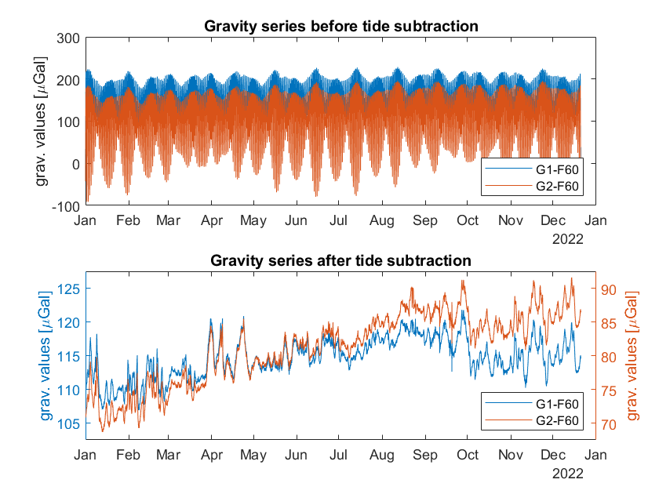
Tides
Fig. 11: Tide subtraction

Slide 19
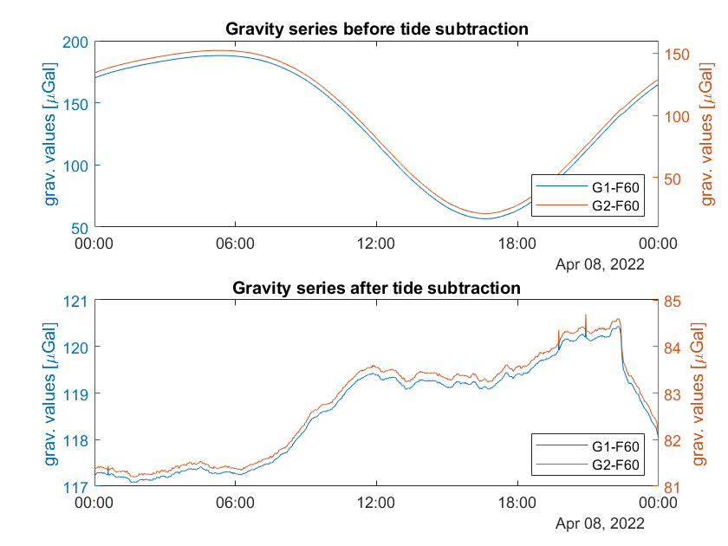
Tides
Fig. 12: Tide subtraction on Apr 8th

Slide 20
Atmospheric pressure

Slide 21
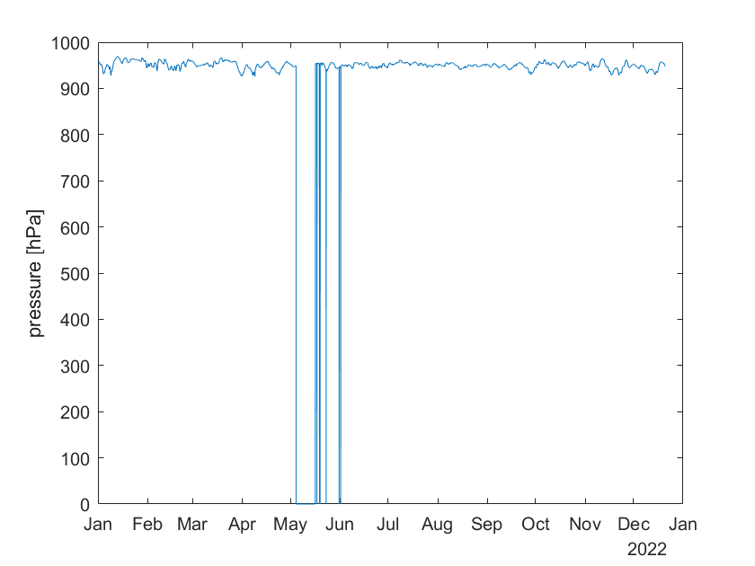
Atmospheric pressure
Fig. 13: Outside pressure series over the year
Notes:
- Data gaps because of interrupted connection between SG and pressure gauge after a storm

Slide 22
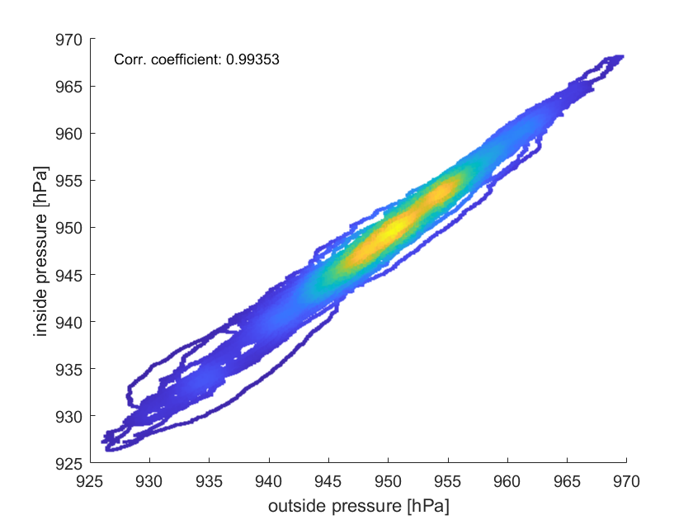
Atmospheric pressure
Fig. 14: Density scatter plot between inside and outside pressure

Slide 23
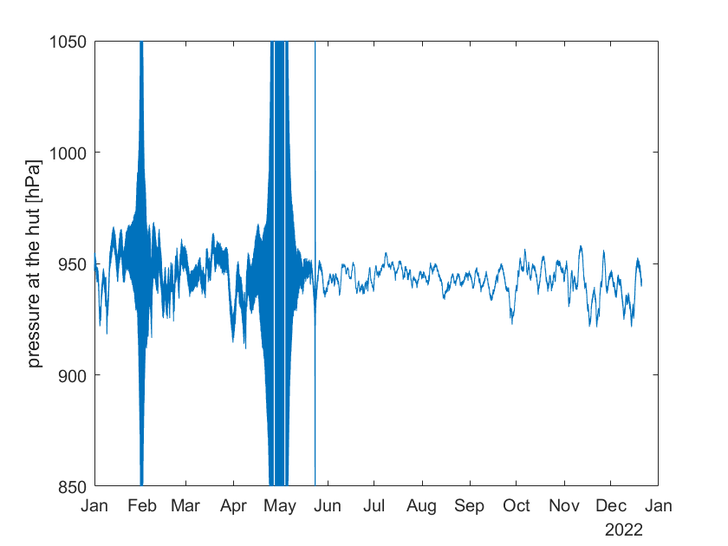
Atmospheric pressure
Fig. 15: Pressure series at the hut

Slide 24
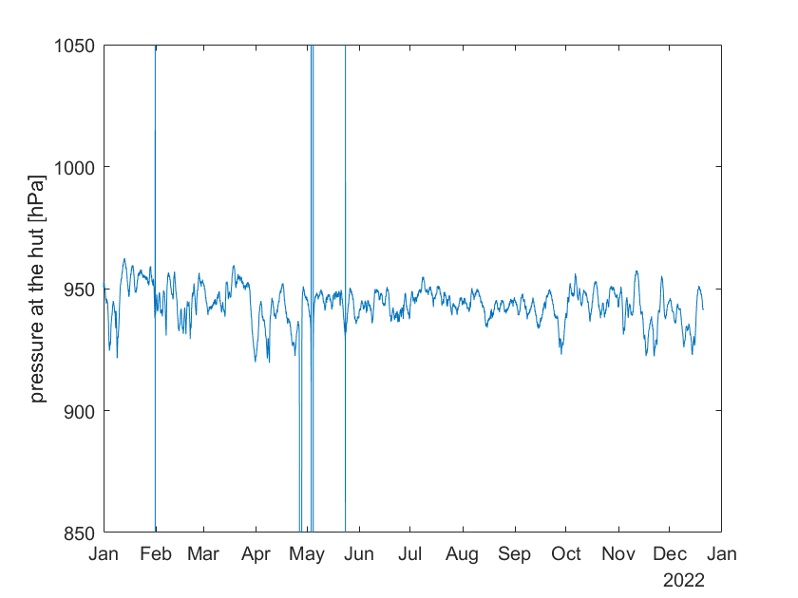
Atmospheric pressure
Fig.16: Pressure series at the hut after filtering

Slide 25
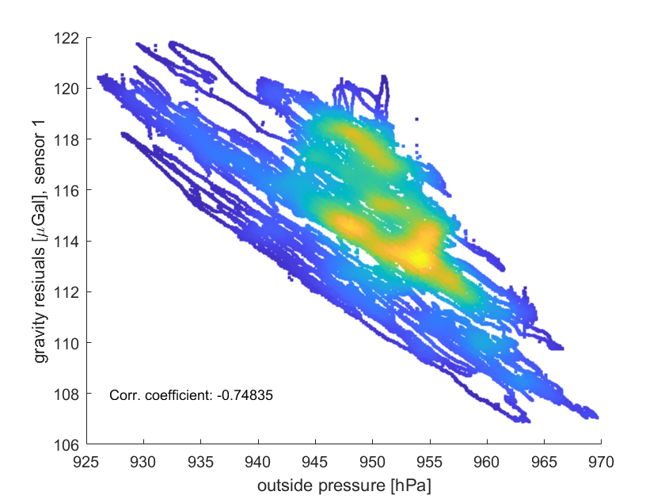
Atmospheric pressure
Fig. 17: Density scatter plot between outside
pressure and gravity residuals
Notes:
- Mention correlation coefficient

Slide 26
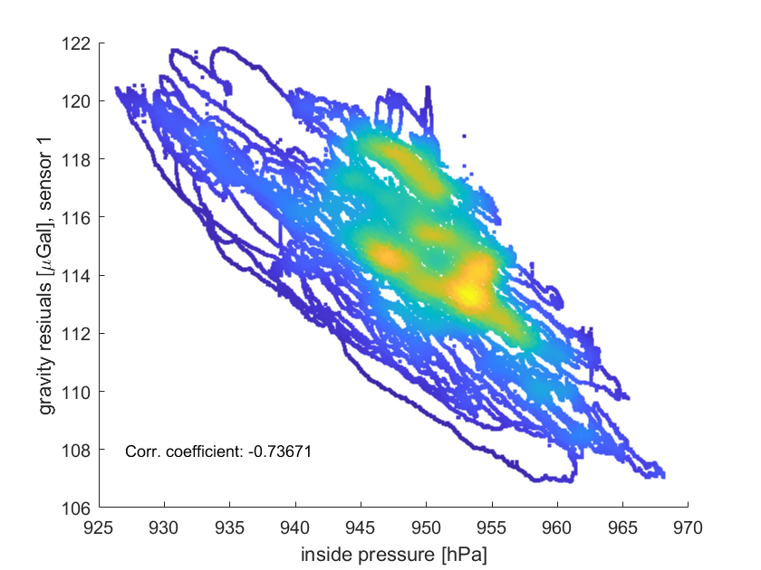
Atmospheric pressure
Fig. 18: Density scatter plot between inside
pressure and gravity residuals
Notes:
- Mention correlation coefficient

Slide 27
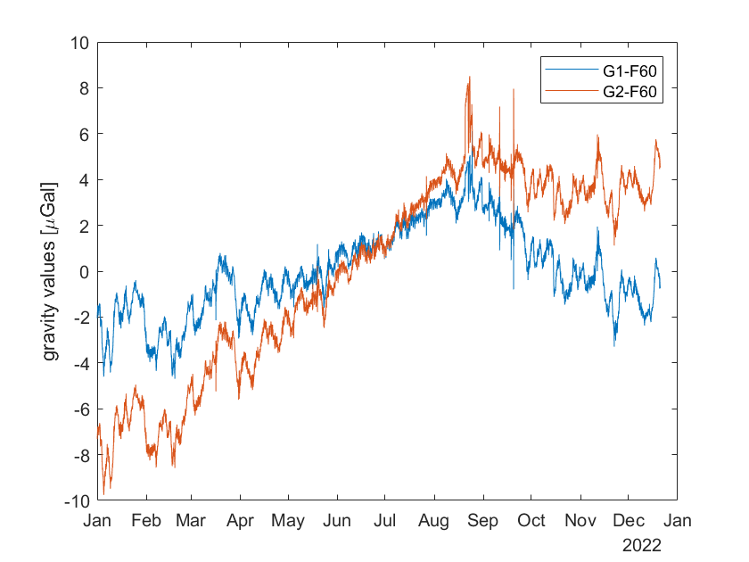
Atmospheric pressure
Fig. 19: Gravity residuals after pressure correction, gaps filled
by inside pressure

Slide 28
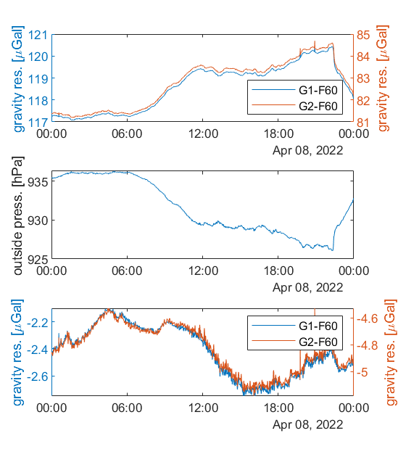
Atmospheric pressure
Fig. 21: Gravity residuals on April 8th before and after atmospheric correction

Slide 29
Atmospheric pressure

Slide 30
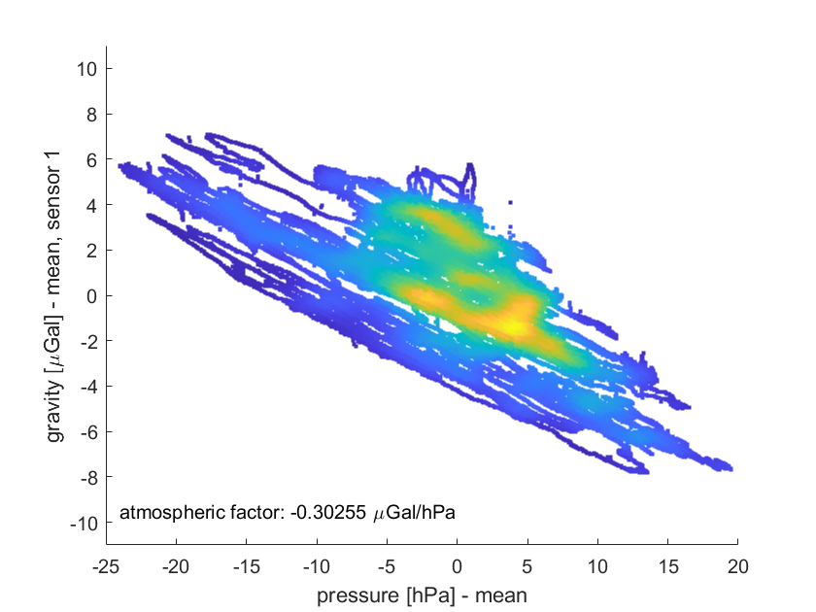
Atmospheric factor
Fig. 22: Density scatter plot between outside pressure and gravity residuals of sensor 1, without drift correction

Slide 31
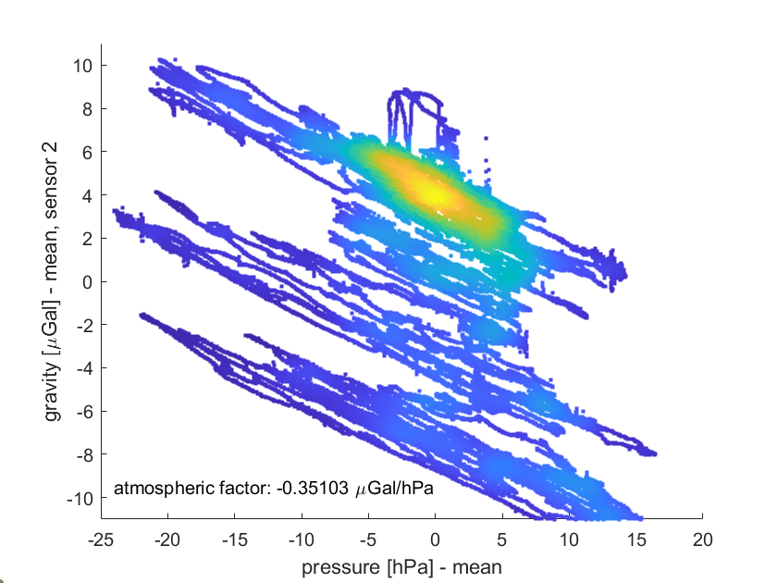
Atmospheric factor
Fig. 23: Density scatter plot between outside pressure and gravity residuals of sensor 2, without drift correction

Slide 32
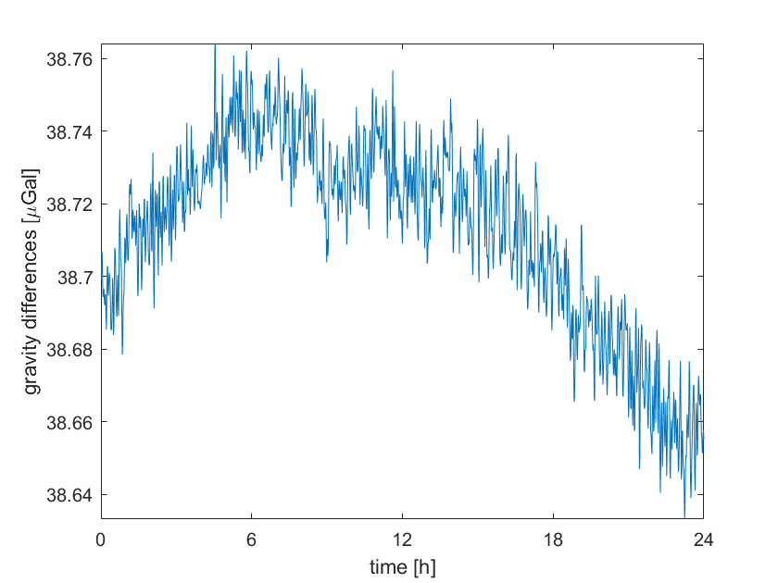
Gravity measurements
Fig. 3: Difference between two sensors on Jan 1st
Accuracy of SG: better than 0.04 μGal
Trend is bigger than that, correlation with magnitude of gravity

Slide 33
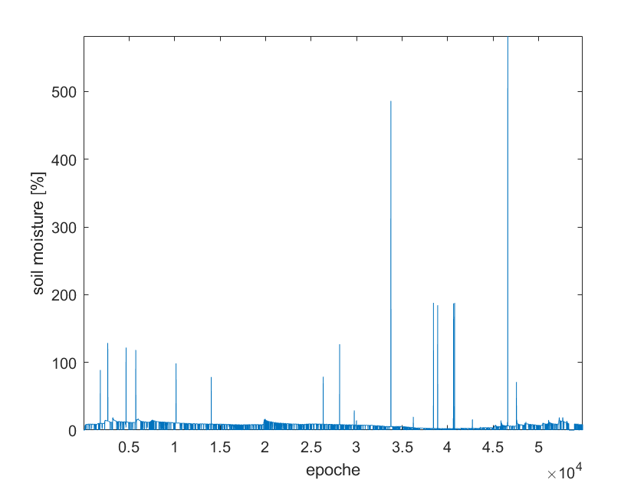
Hydrology
Fig. 10: Recorded soil moisture over the year (Solidus 1, probe 0)
Includes many outliers -> filtering, linear interpolation

Slide 34
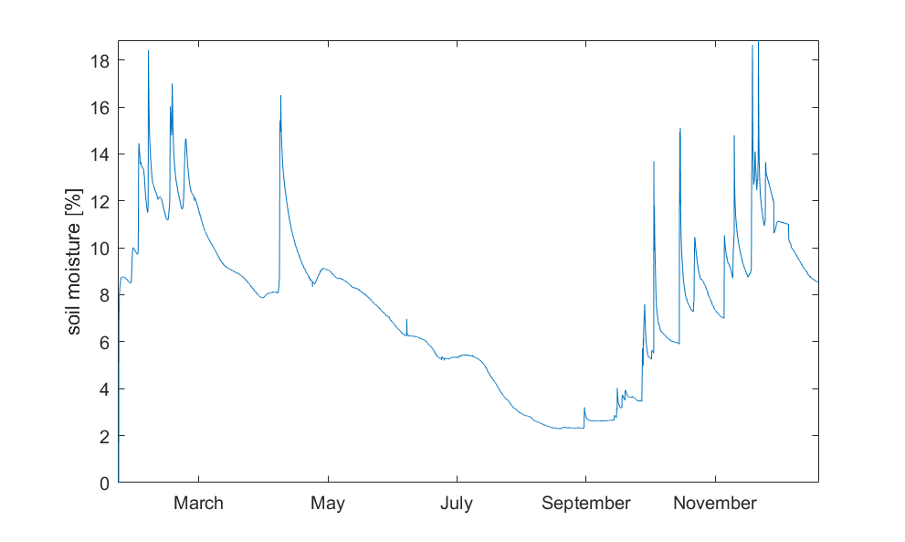
Hydrology
Fig. 11: Soil moisture series after outlier removal (Solidus 1, Probe 0)

Slide 35
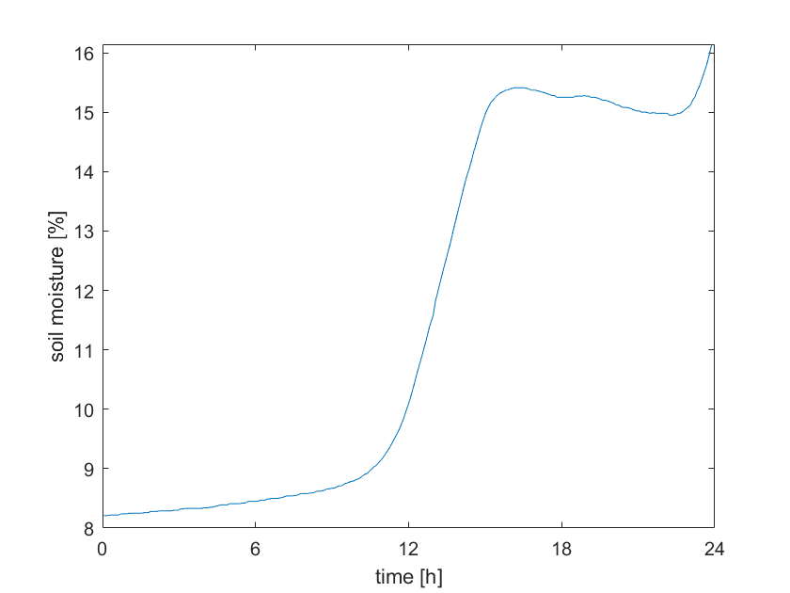
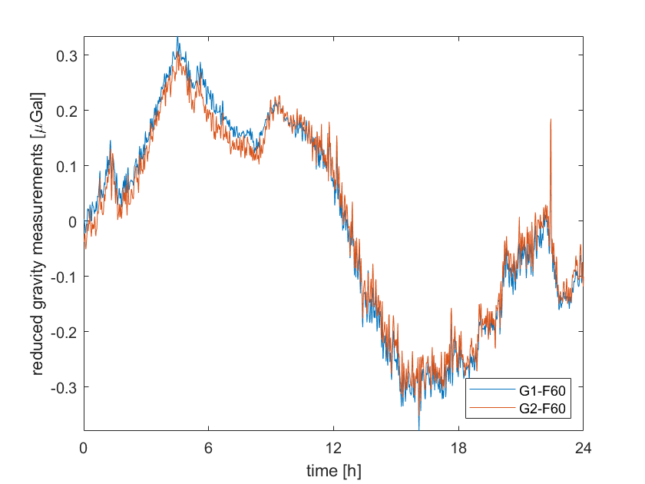
Hydrology
Significant raining event on April 8th
Gravity trend as expected, but there are also other factors involved
Fig. 12: soil moisture and gravity on April 8th

Slide 36
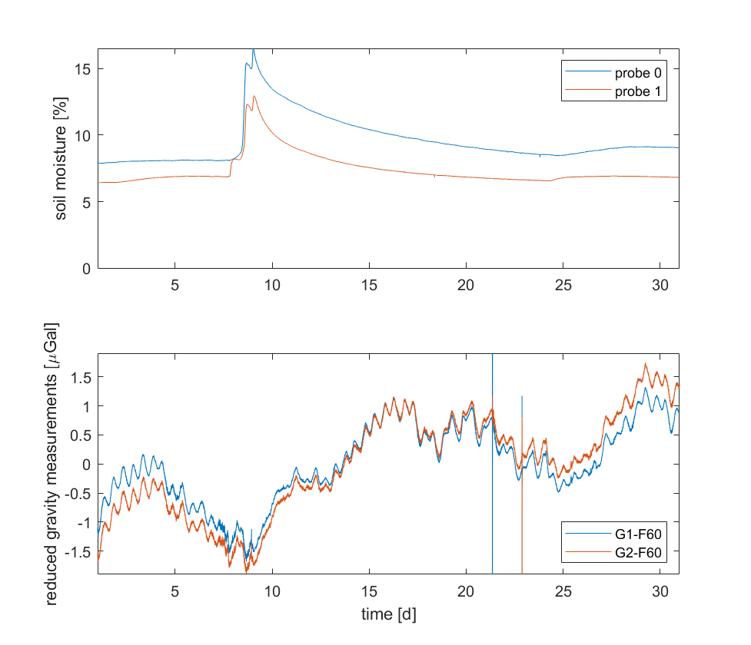
Hydrology
Fig. 13: Comparison of soil mositure (Solidus 1, both probes) and gravity over the month of April

Slide 37
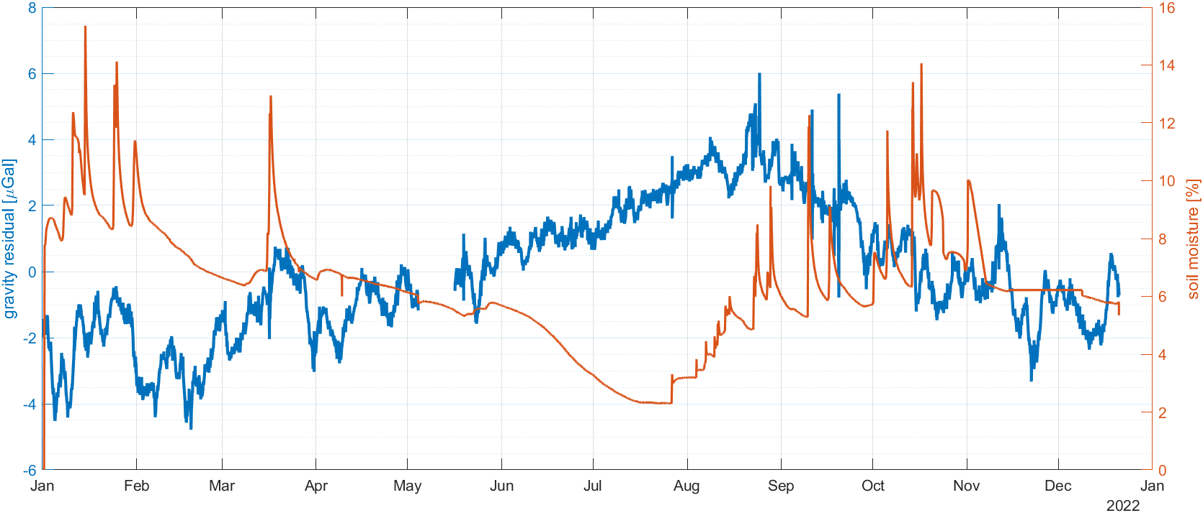
Hydrology
Fig. 14: Comparison of soil mositure (Solidus 1, both probes) and gravity over the year

Slide 38
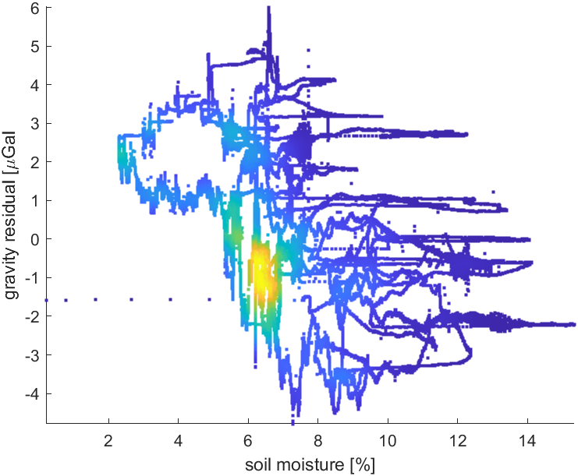
Hydrology
Fig. 15: Scatter plot of soil mositure and gravity residuals

Slide 39
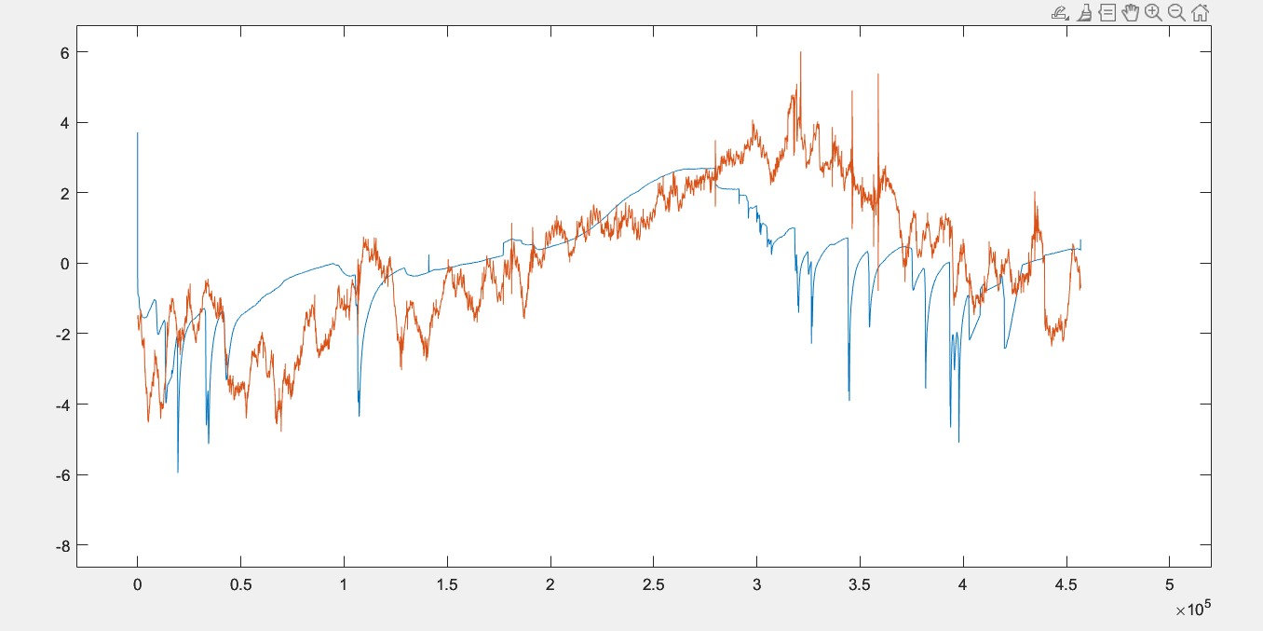
Hydrology
Fig. 16: results after fiting a scale

Slide 40
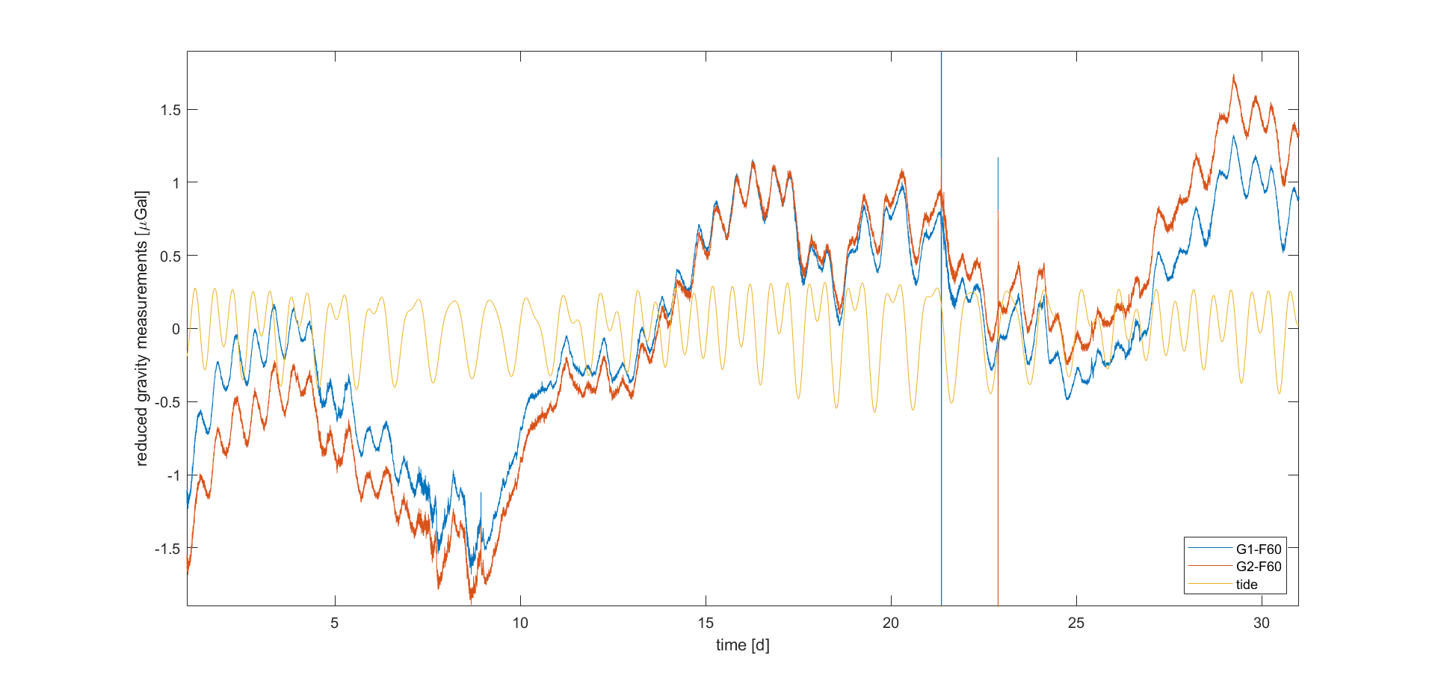
Hydrology
Fig. 14: Comparison of gravity in April with the synthetic tides (not to scale)
A clear half-daily period remains -> is there a residual tidal effect remaining?
Comparison shows a small phase difference

Slide 41
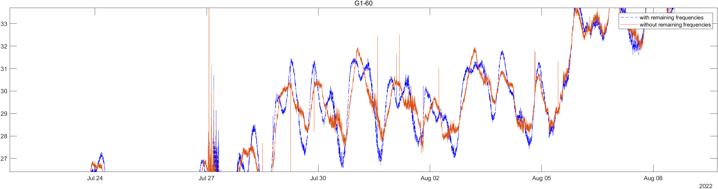
Adjustment
Fig. 14: with remaining frequencies (blue);without remaining frequencies red)

Slide 42
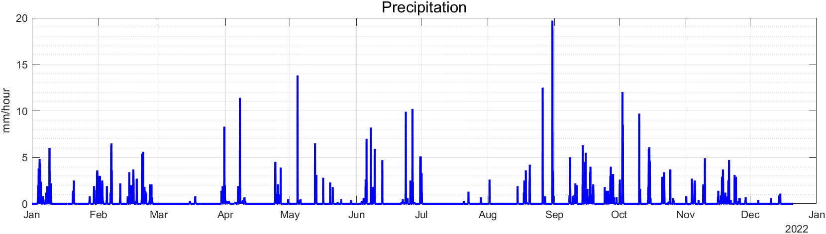
Hydrology
Fig. 15: Precipitation in mm/hour

Slide 43
GRACE
GRACE Follow-On data up to degree 96 without filtering from ICGEM
Monthly solution only up to October
Adding of degree 1 coefficients and replacing C2,0 and C3,0 from the GRACE Technical Notes #13 and #14 of the NASA GRACE documentation

Slide 44
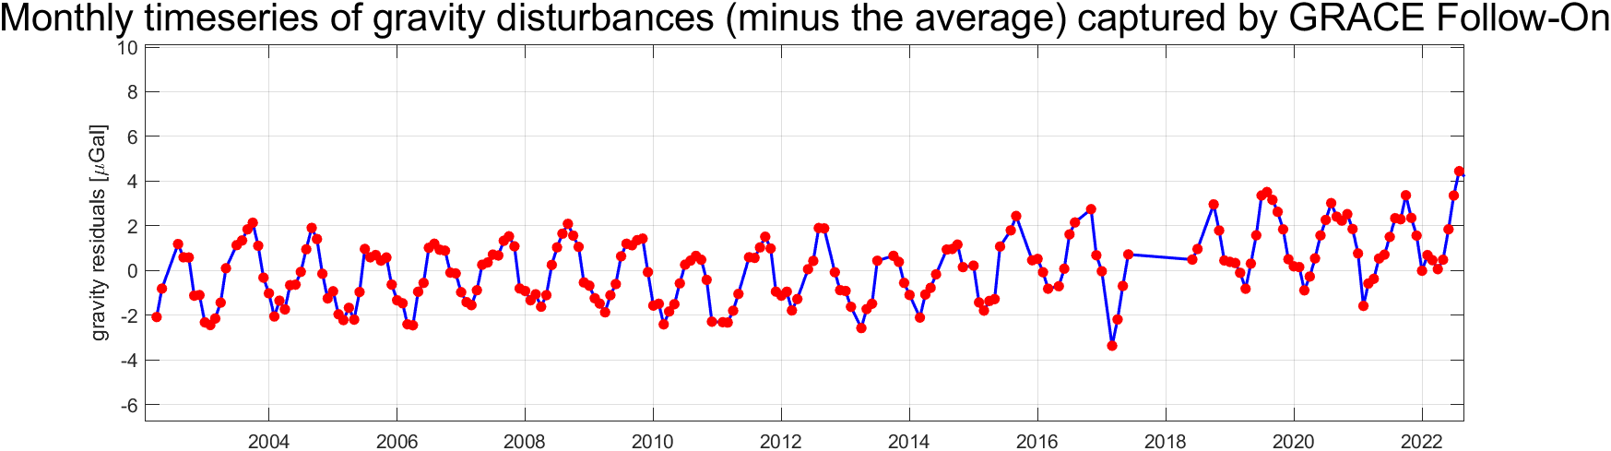
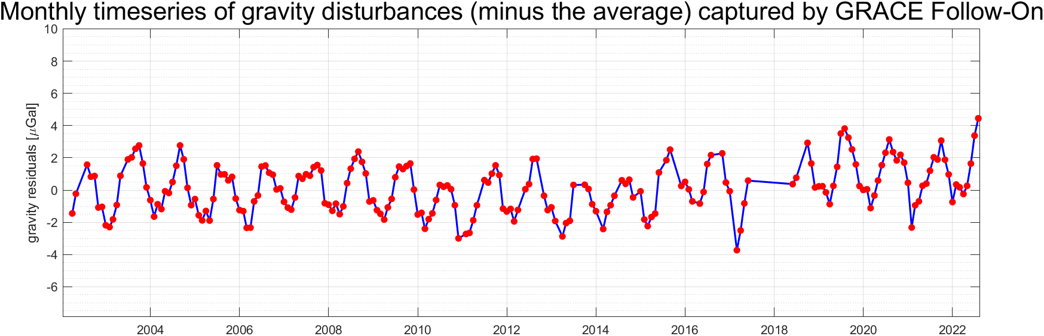
Gaussian filter
Fig. 15: Radius = 1000 km (above); Radius = 600 km (bottom) almost no change

Slide 45
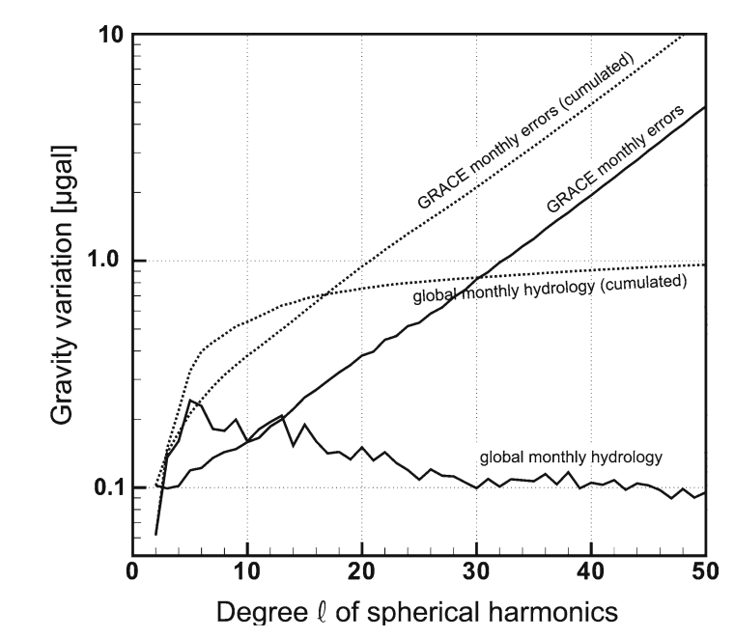
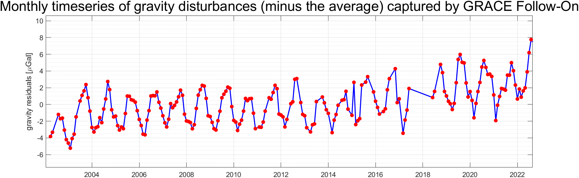
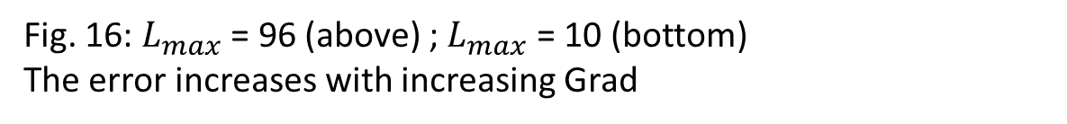
Degree
Fig. 16: $L_{max}$ = 96 (above) ; $L_{max}$ = 10 (bottom) The error increases with increasing Grad

Slide 46
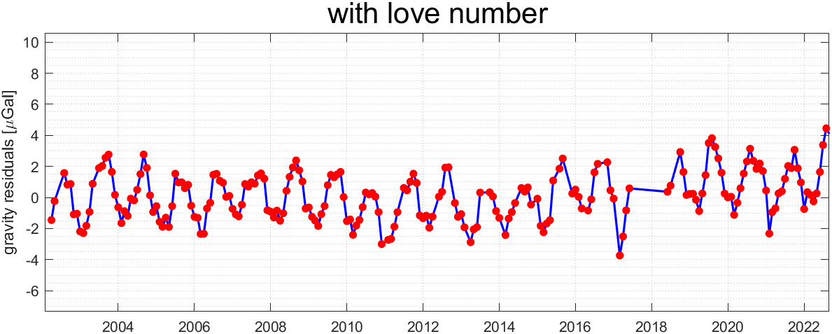
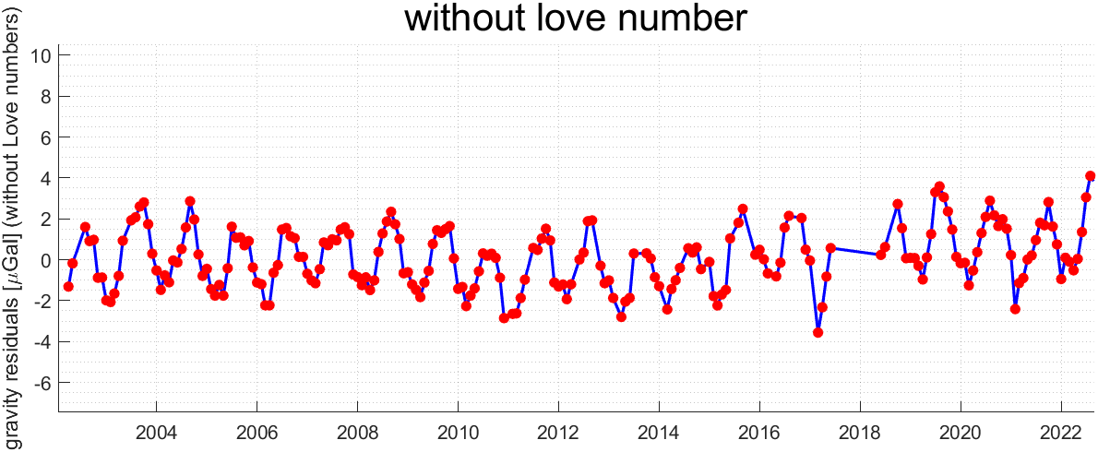
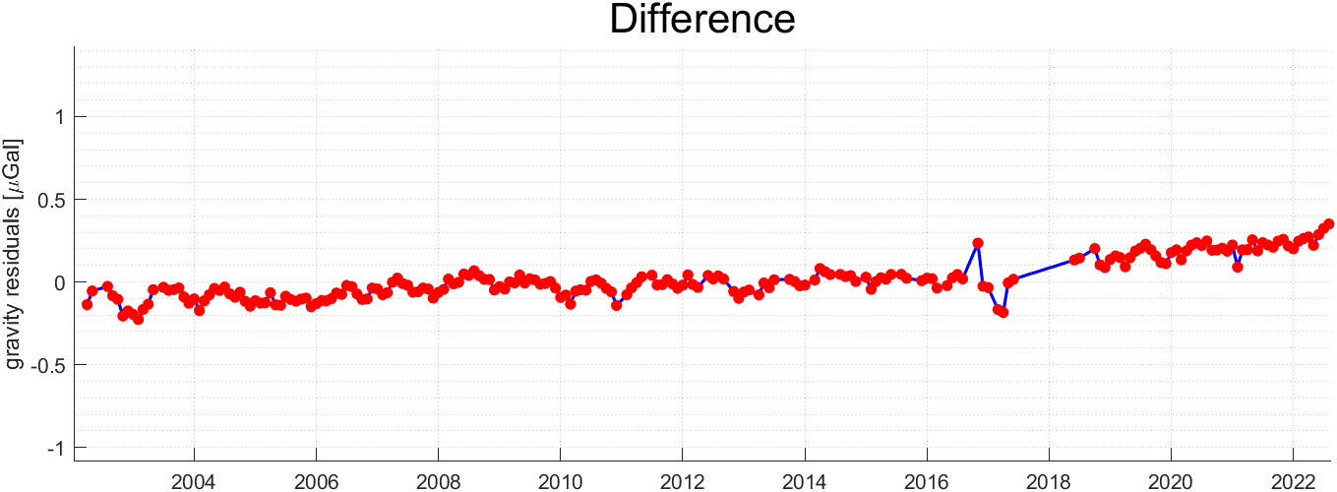
Love number
Fig. 17: with love number (above) ; without love number (middle) difference (bottom)

Slide 47
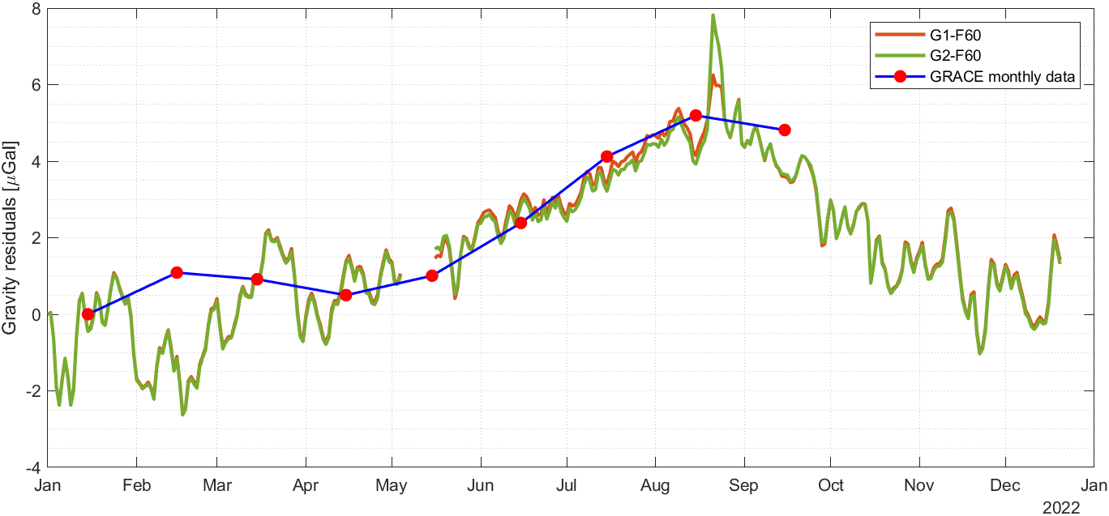
Comparison
Fig. 18: Comparison of gravity residuals from SG(daily mean) and GRACE/GRACE FO

Slide 48
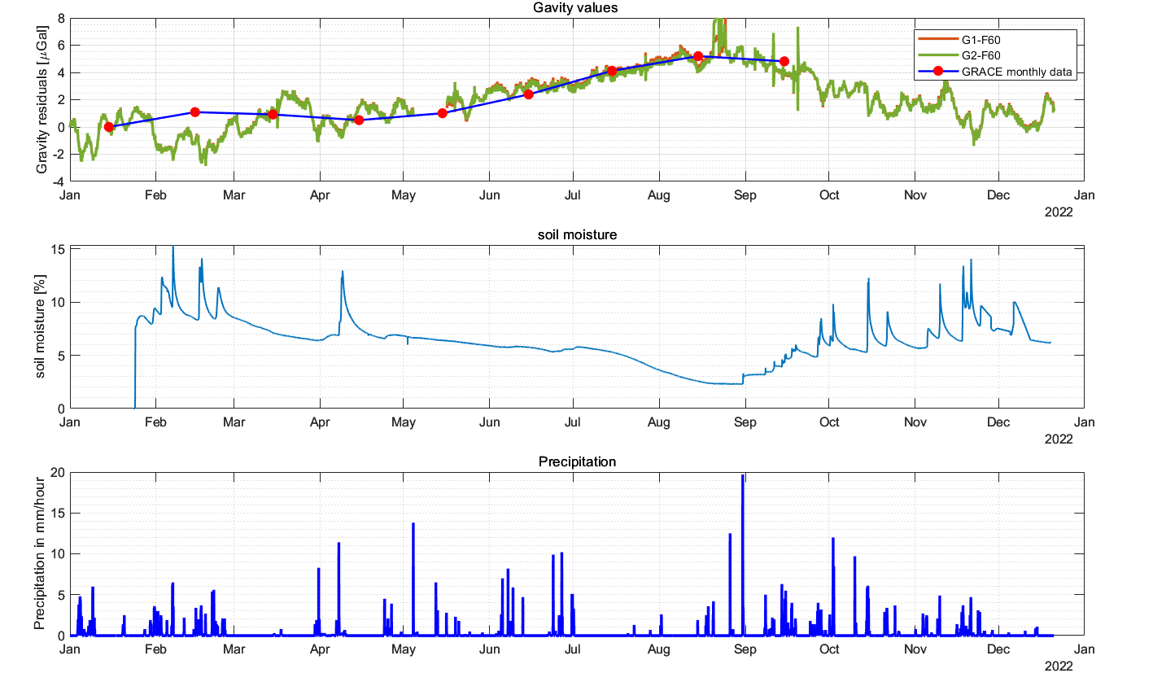
Comparison

Slide 49
Next steps
Fit a model for the effect of soil moisture
Eliminating half-daily period in data?
SSA and wavelet analysis
Comparing with rain gauge data
Comparison with GRACE and HydroData
Models for mass changes in Earth‘s mantel?
Analyse the different soil moisture series

